Slide 1
Jon’S STATION
-”STOP BY AND PICK UP THE GAME THAT YOU LIKE.”
Jonathan Ardelean

Slide 2
KING OF THE ROAD!
-BEST GAME OUT ON THE MARKET IN 2017

Slide 3




EXAMPLES OF THE GAME ELEMENTS!

Slide 4


Slide 5
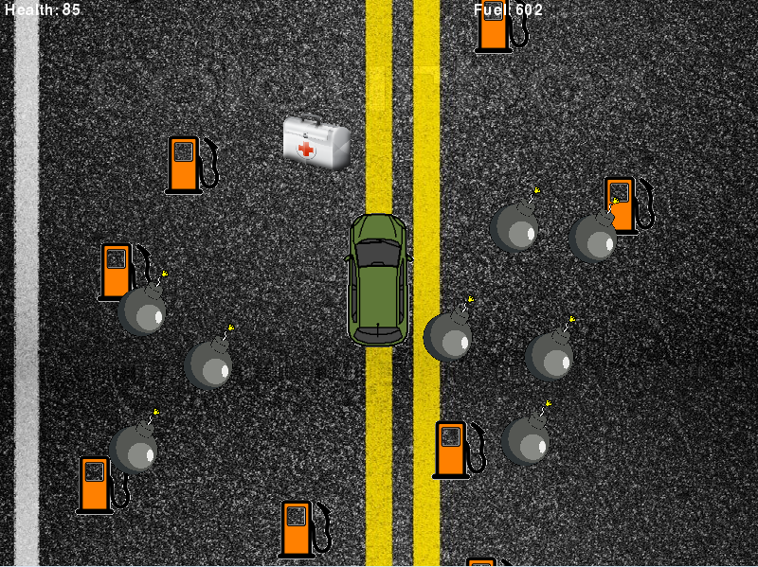

Slide 6
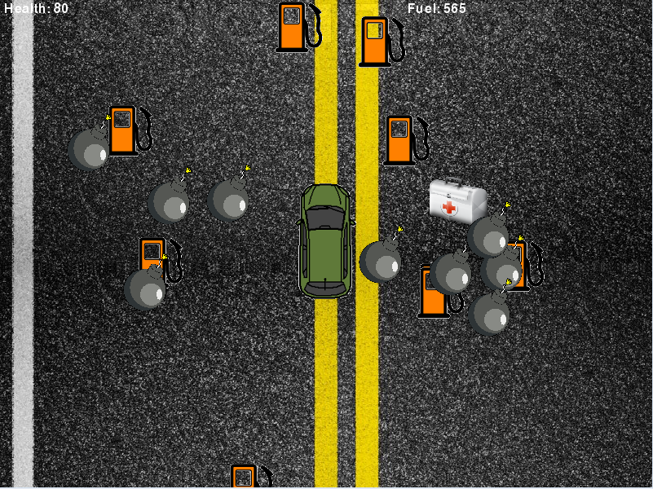

Slide 7
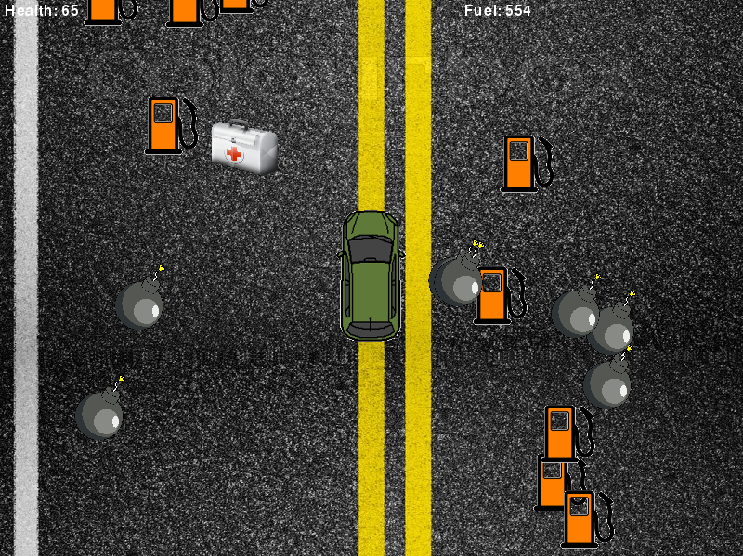

Slide 8
